Slide 1
Sex-Specific GWAS
Carrie Zhu

Slide 2
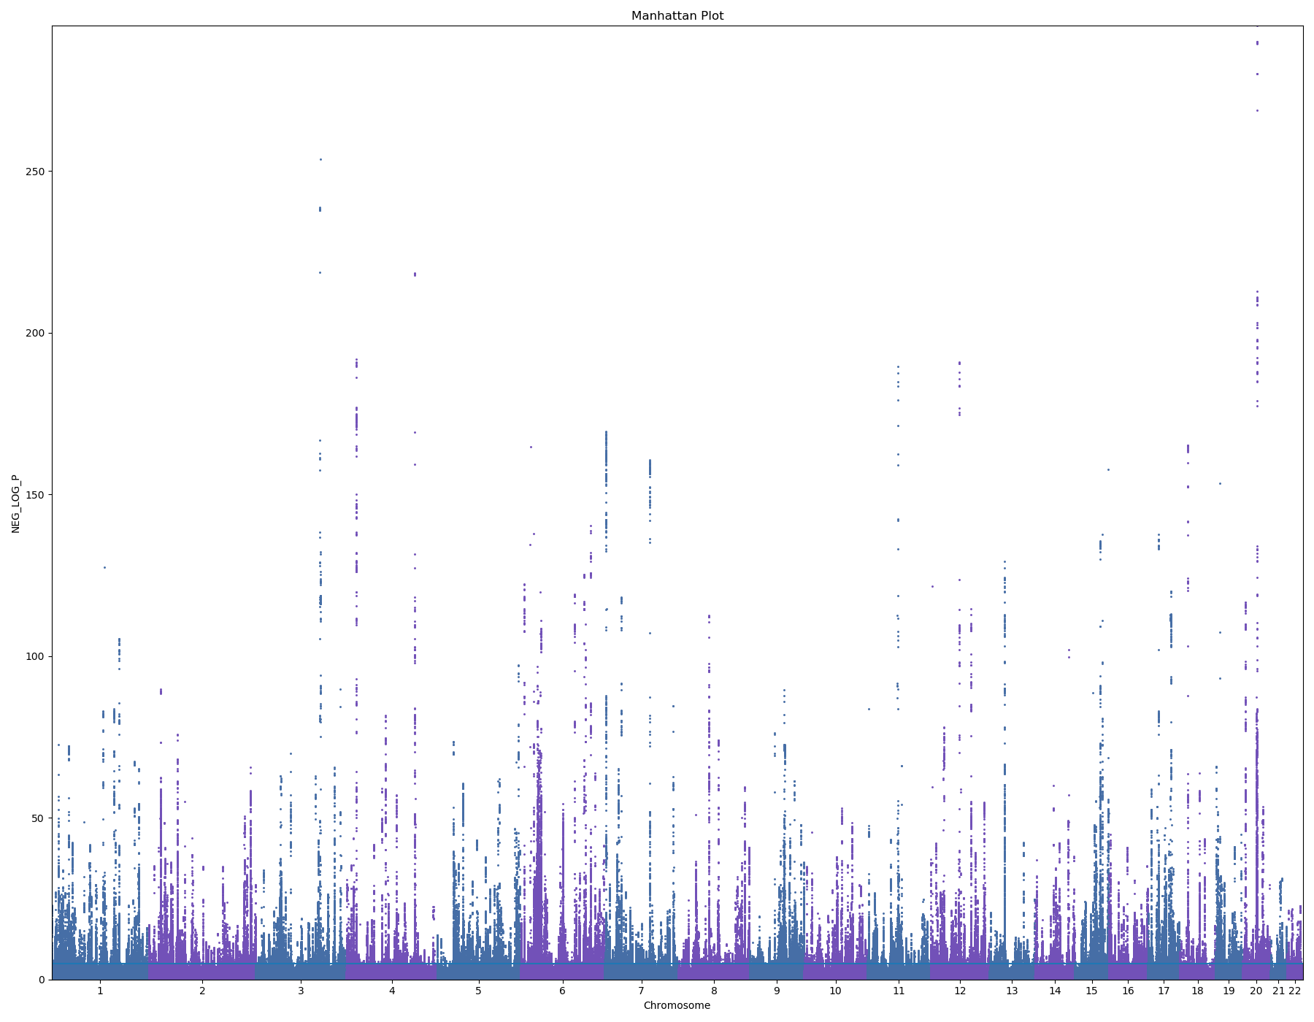
Height
429282 samples

Slide 3
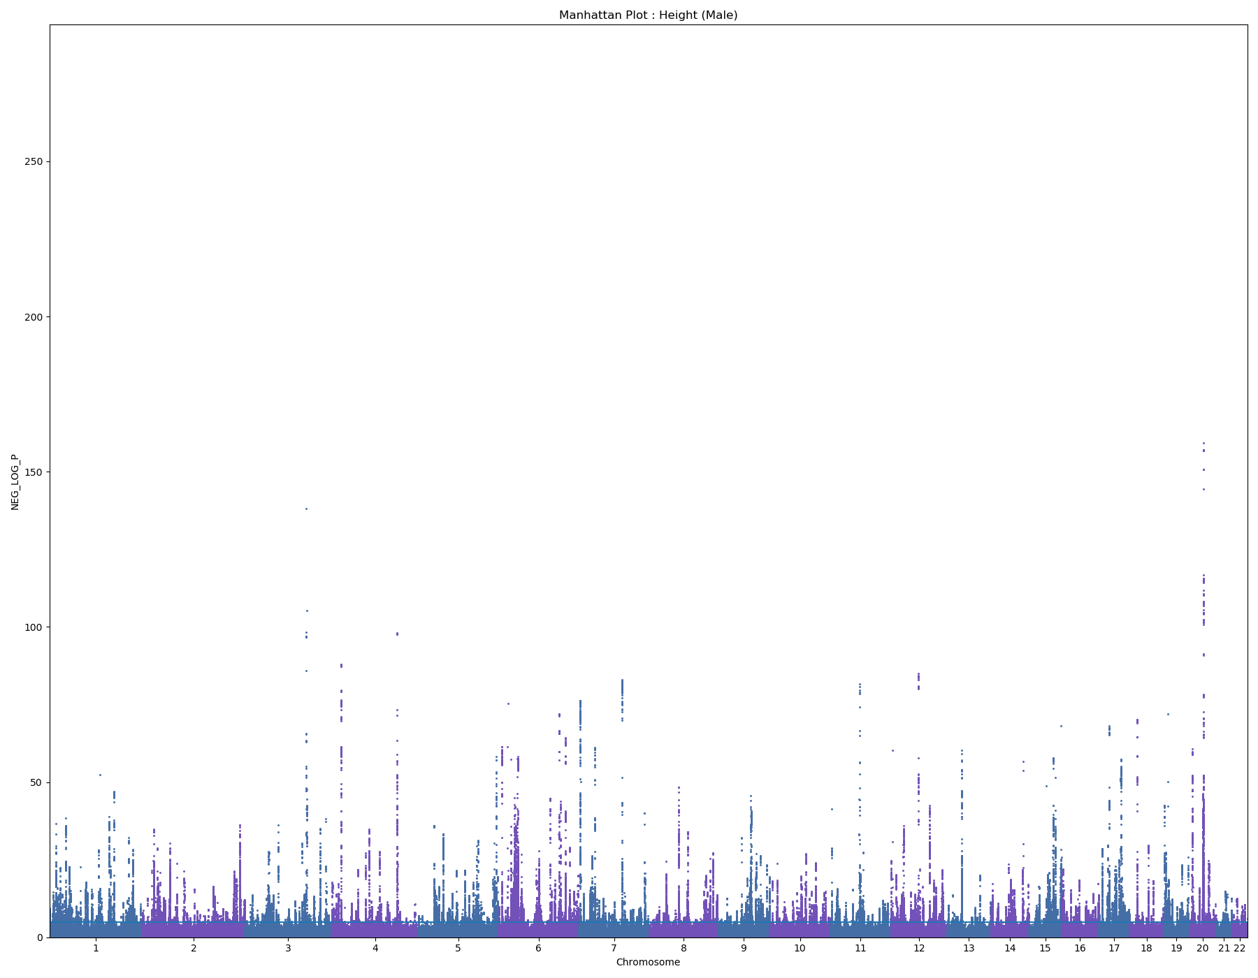
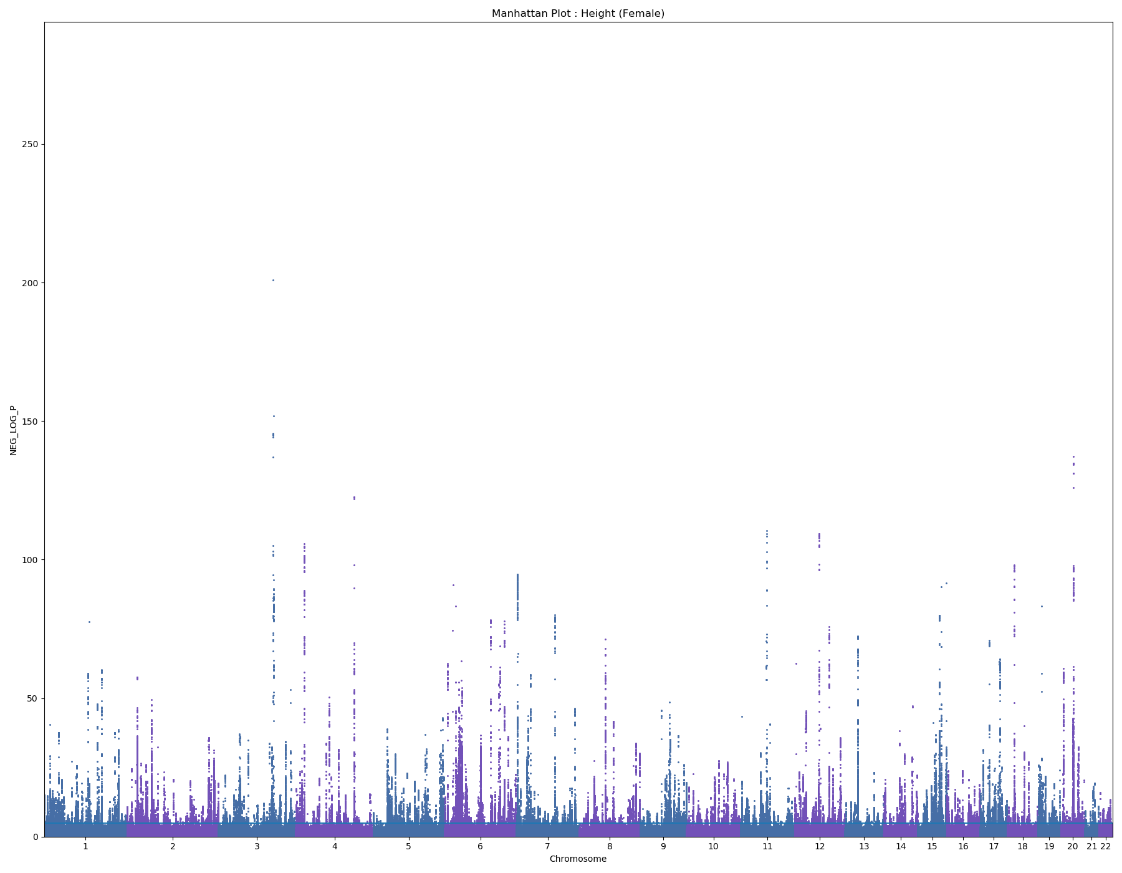
Height
Male – 196867 samples
Female – 232415 samples

Slide 4
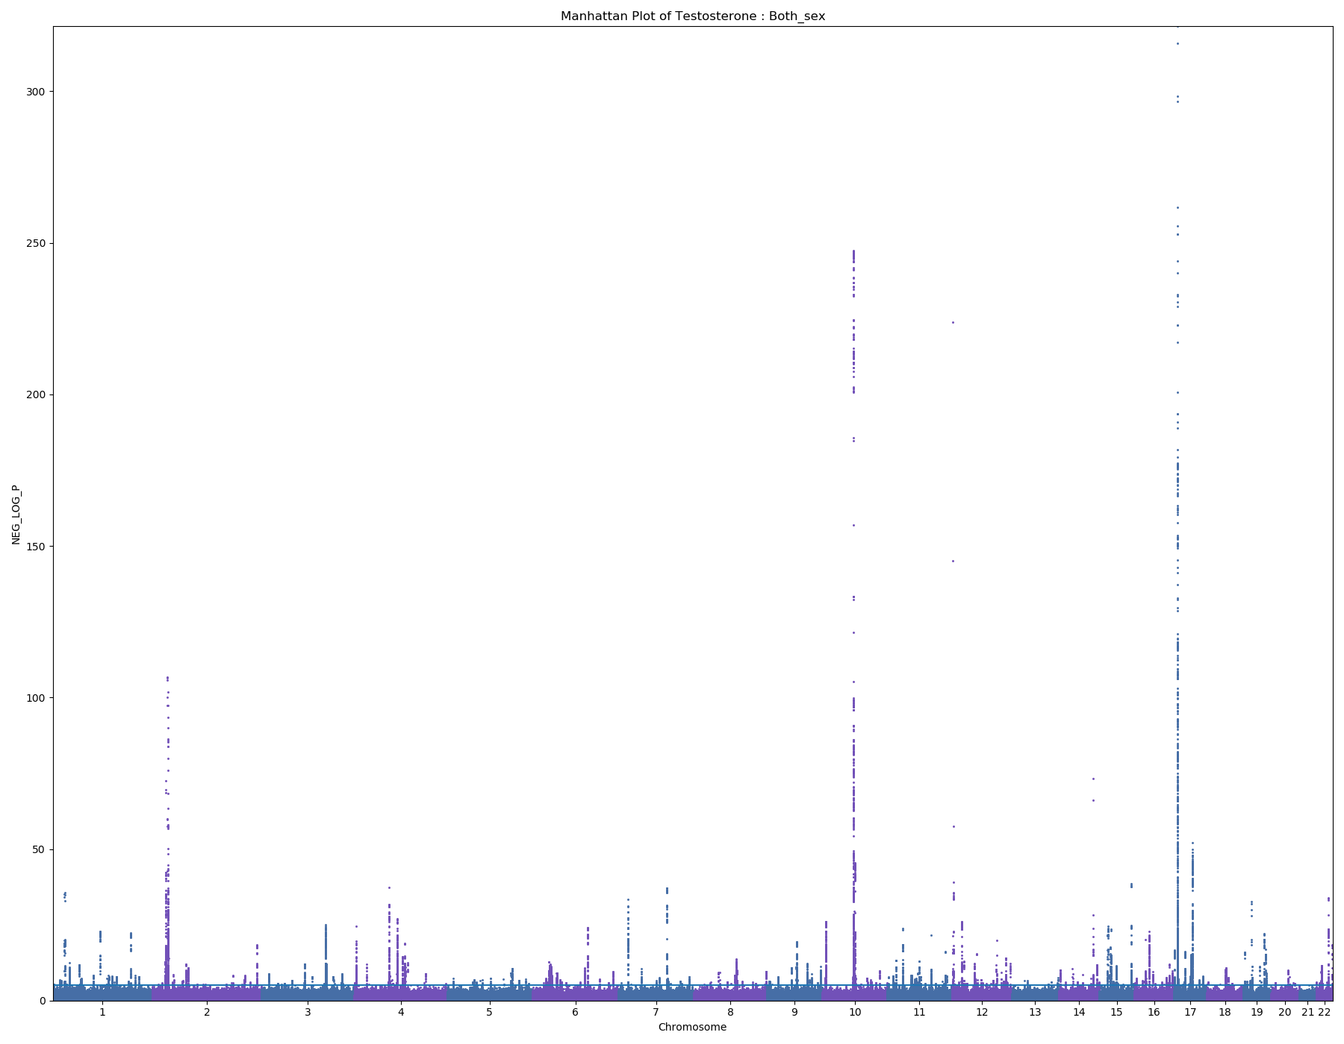
Testosterone
371438 samples

Slide 5

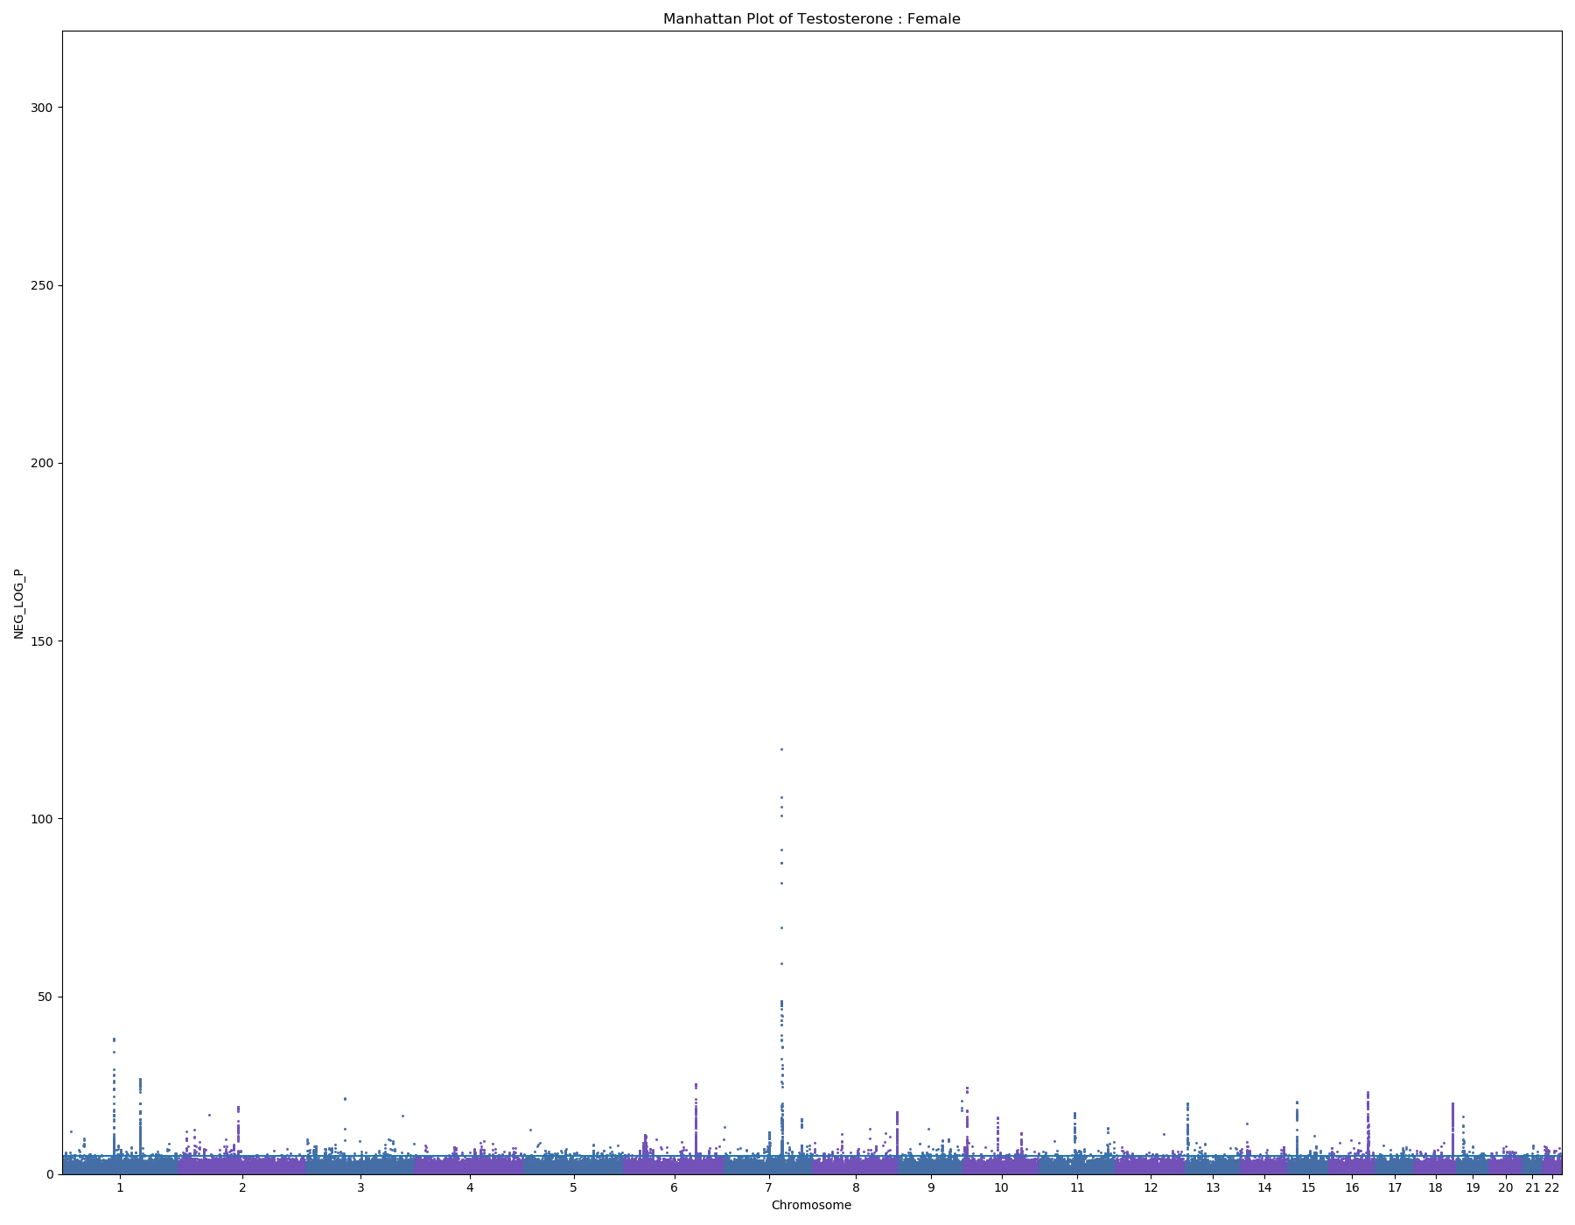
Testosterone
Male – 186456 samples
Female – 184982 samples

Slide 6
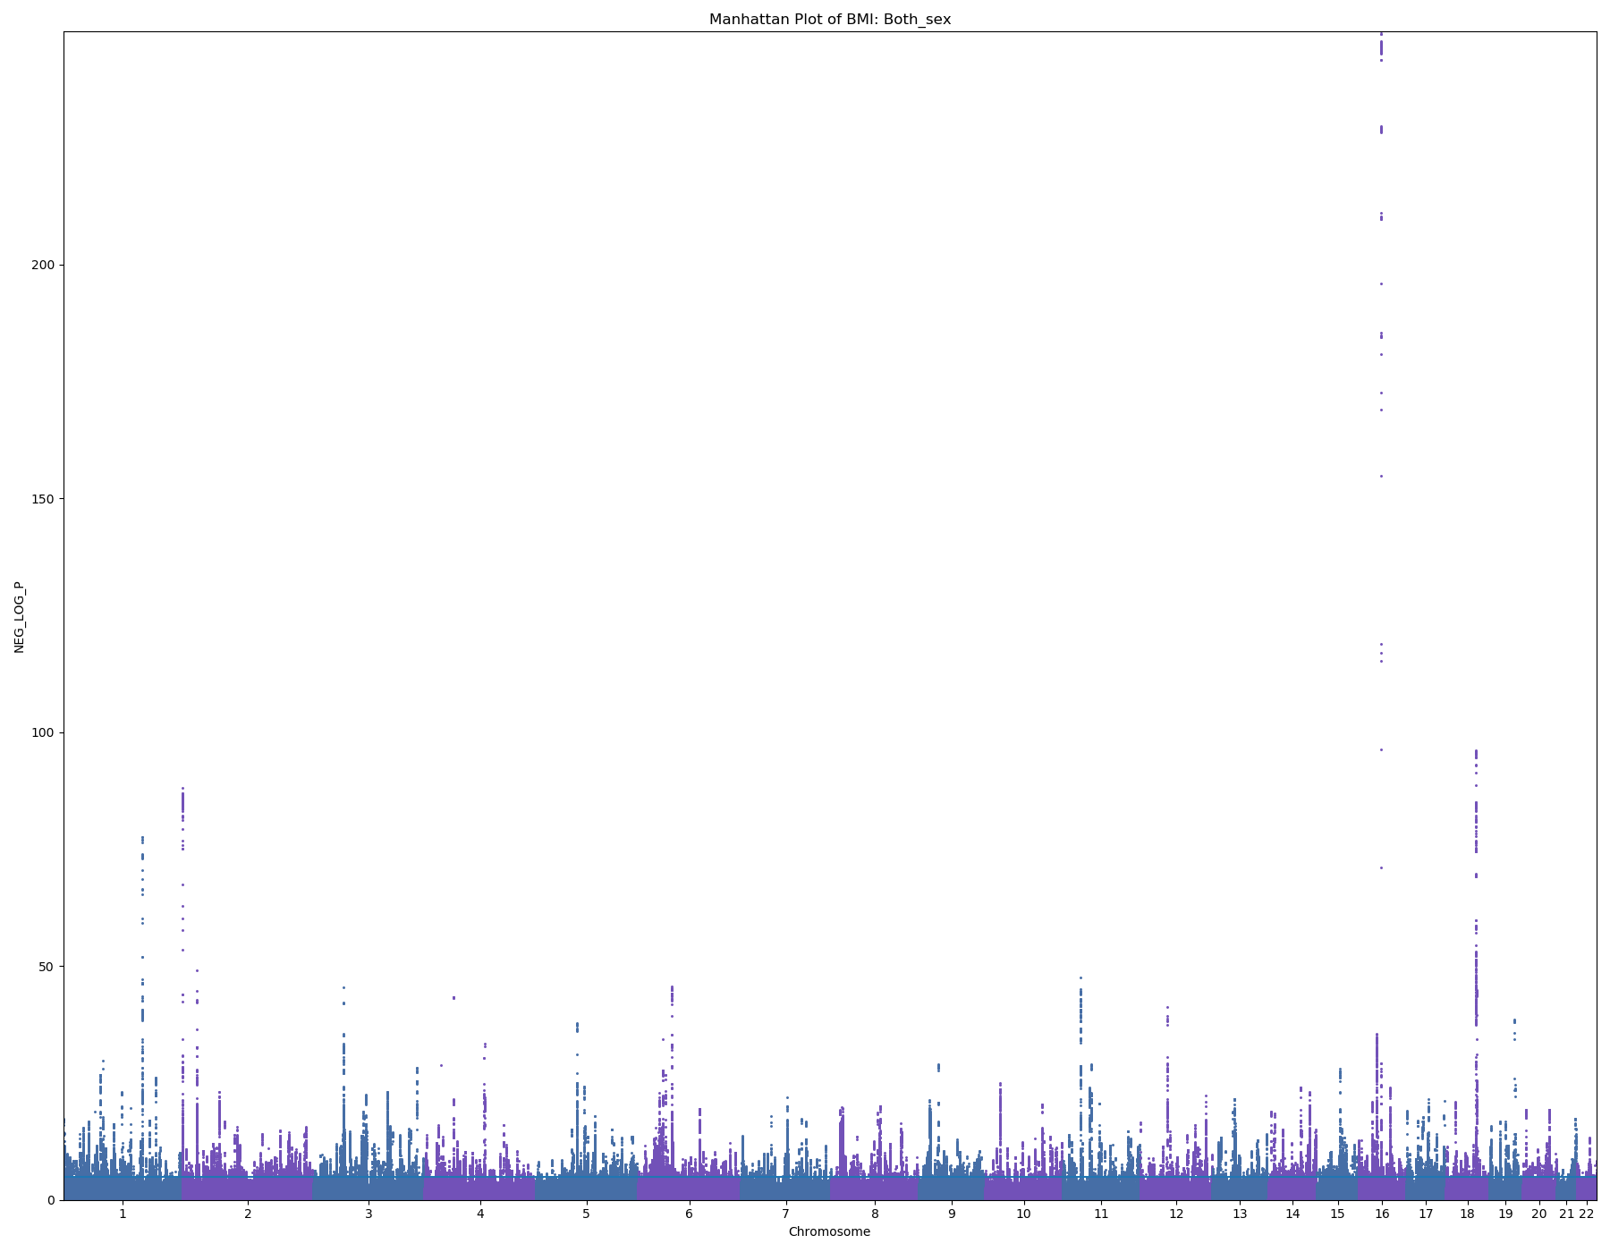
BMI
4288833 samples

Slide 7
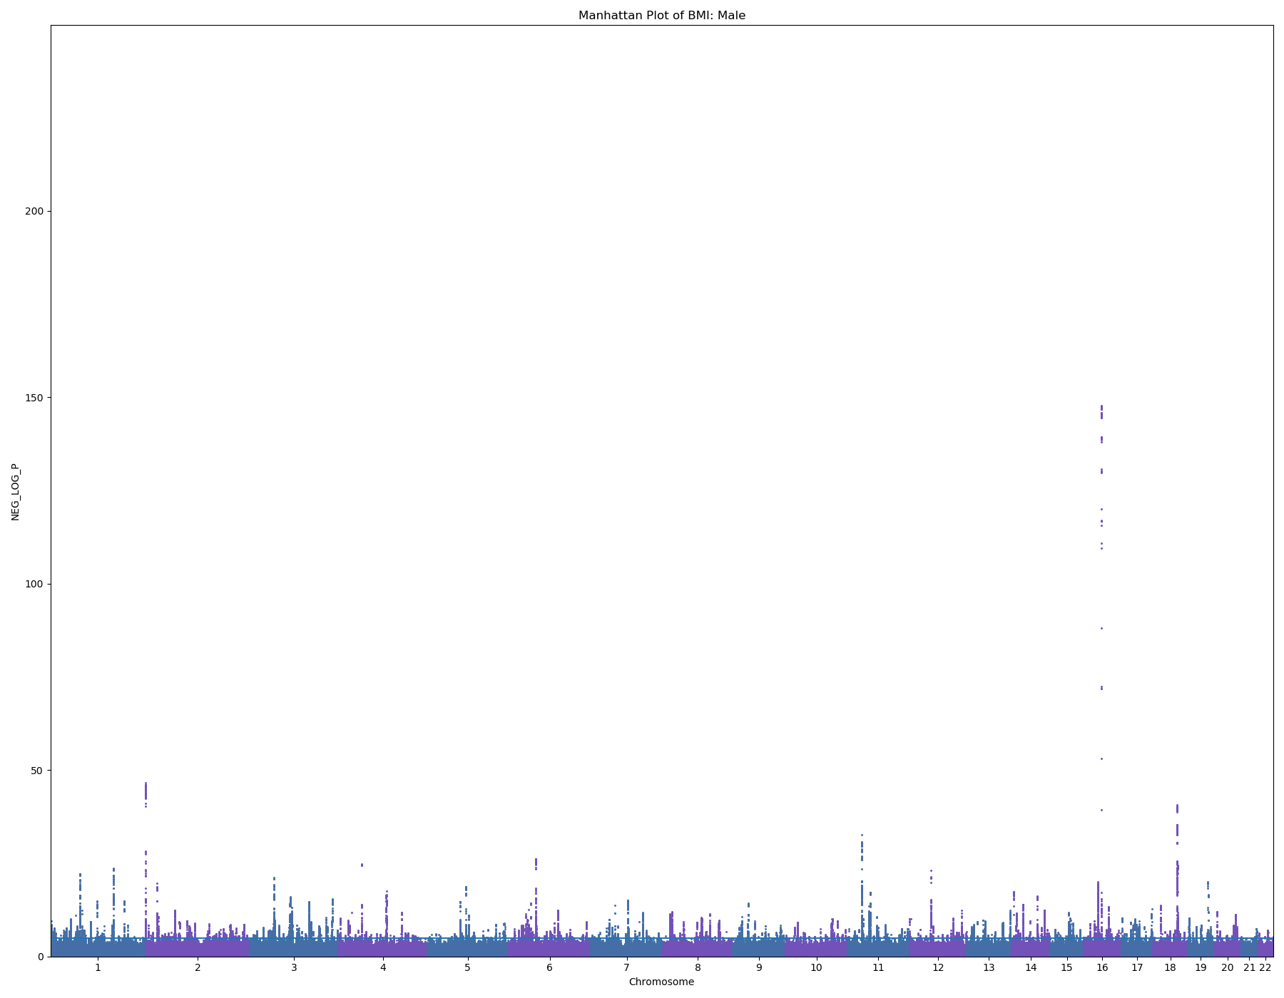
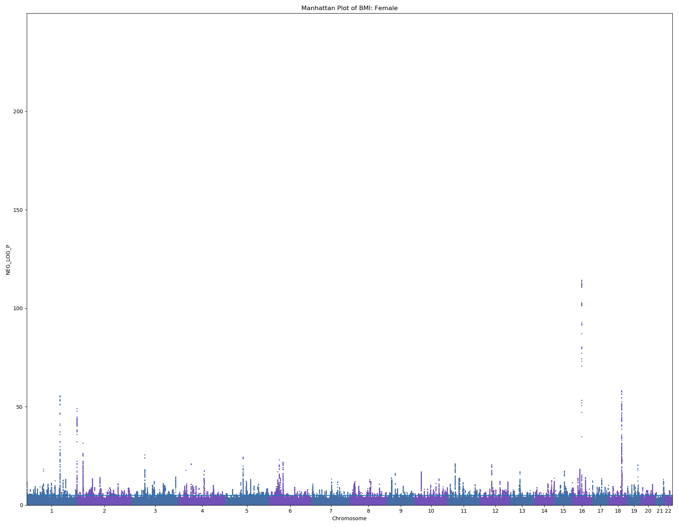
BMI
Male – 196660 samples
Female – 232173 samples

Slide 8
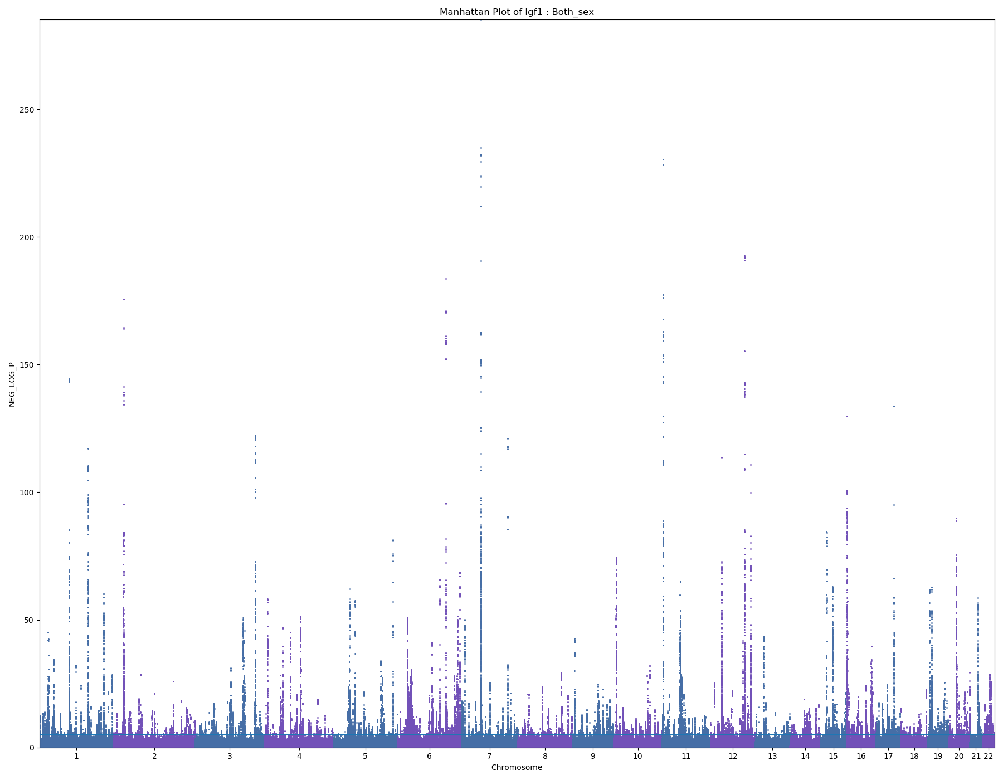
IGF-1
407974 samples

Slide 9
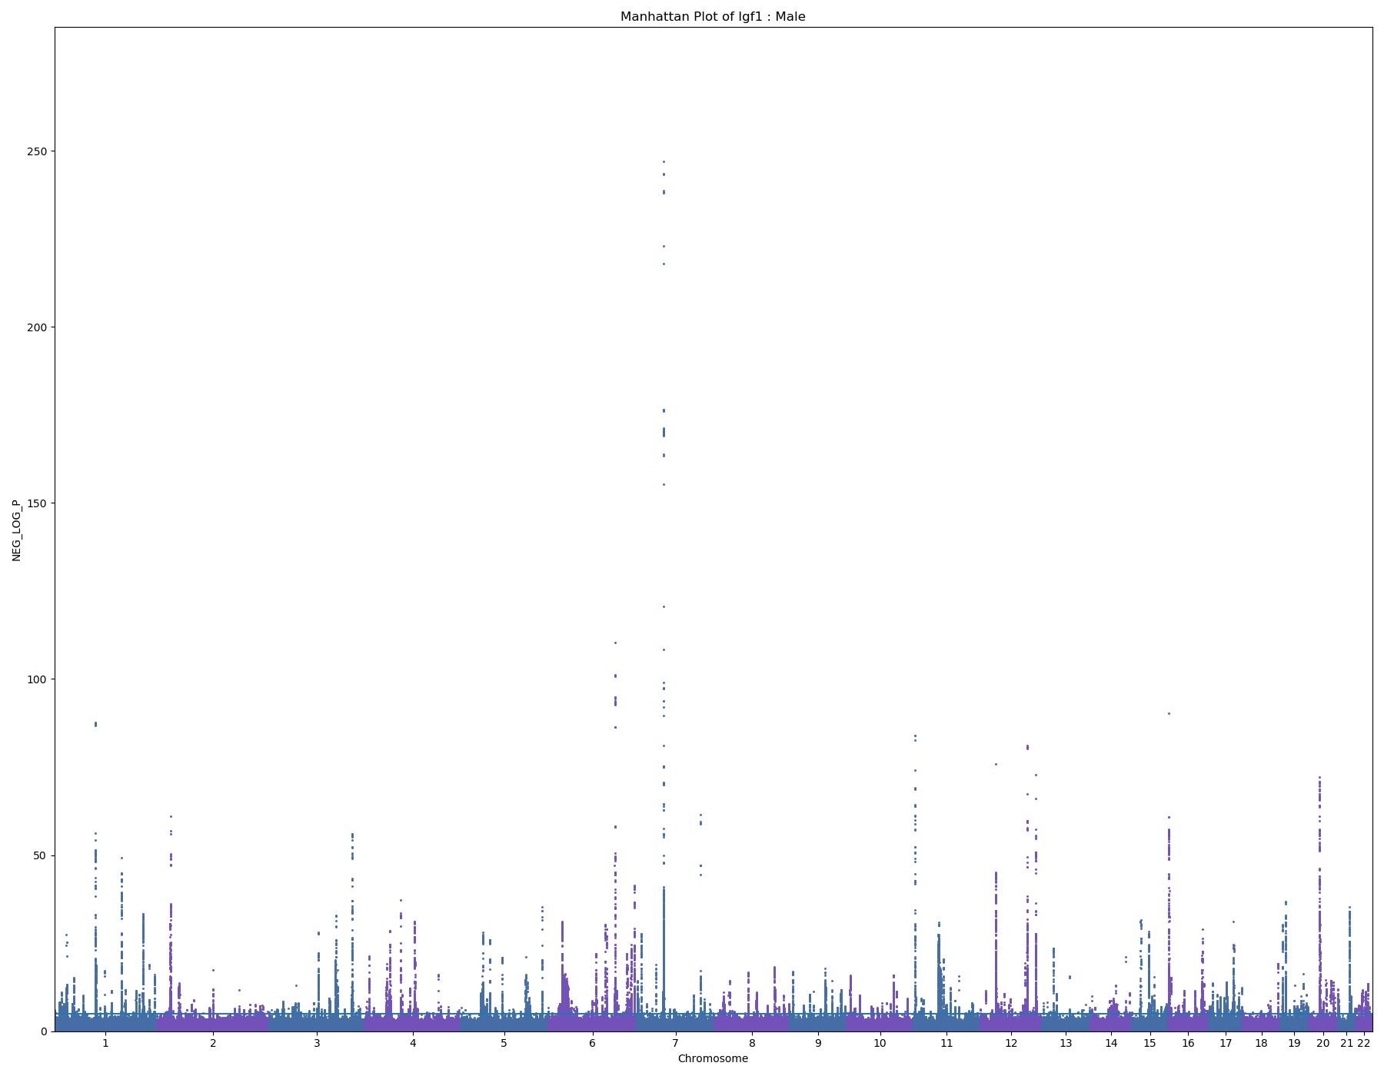
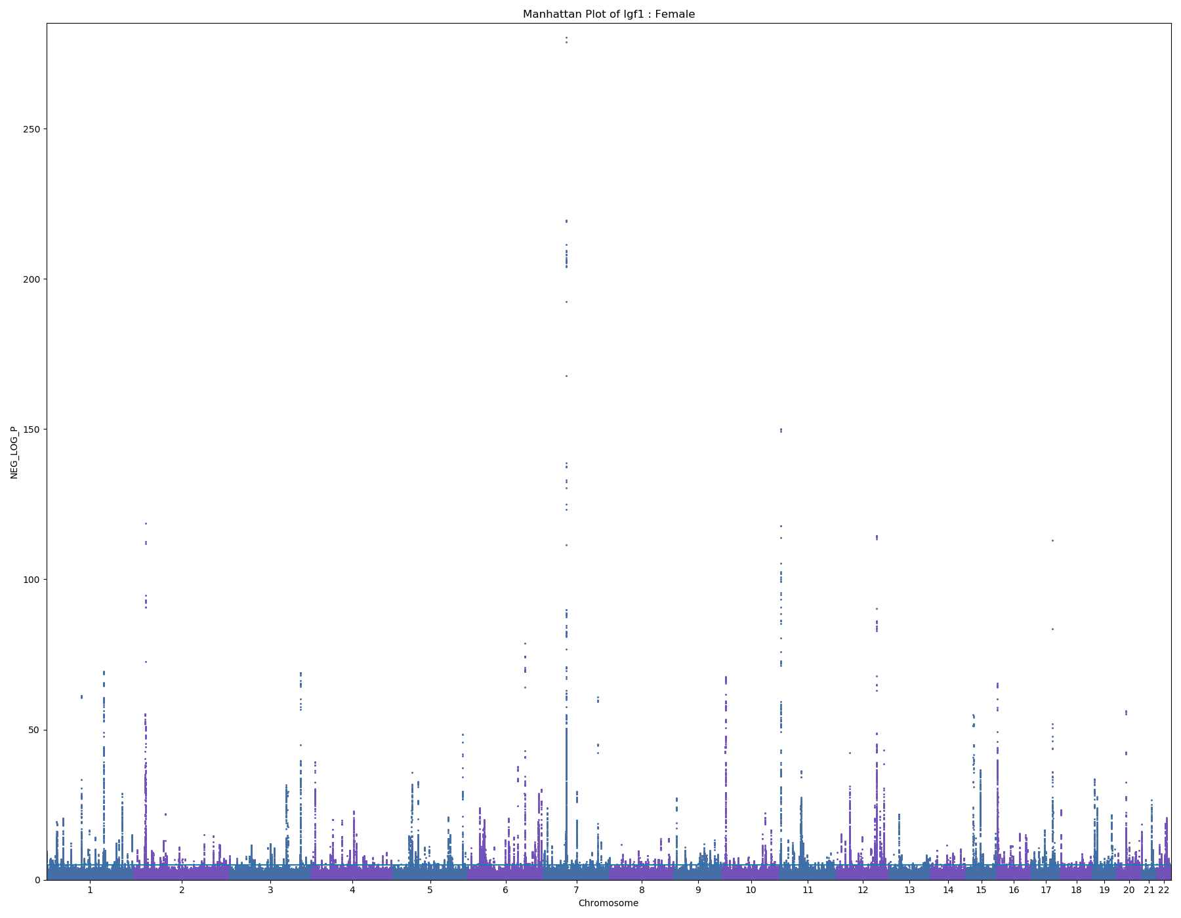
IGF-1
Male – 187303 samples
Female – 220671 samples

Slide 10
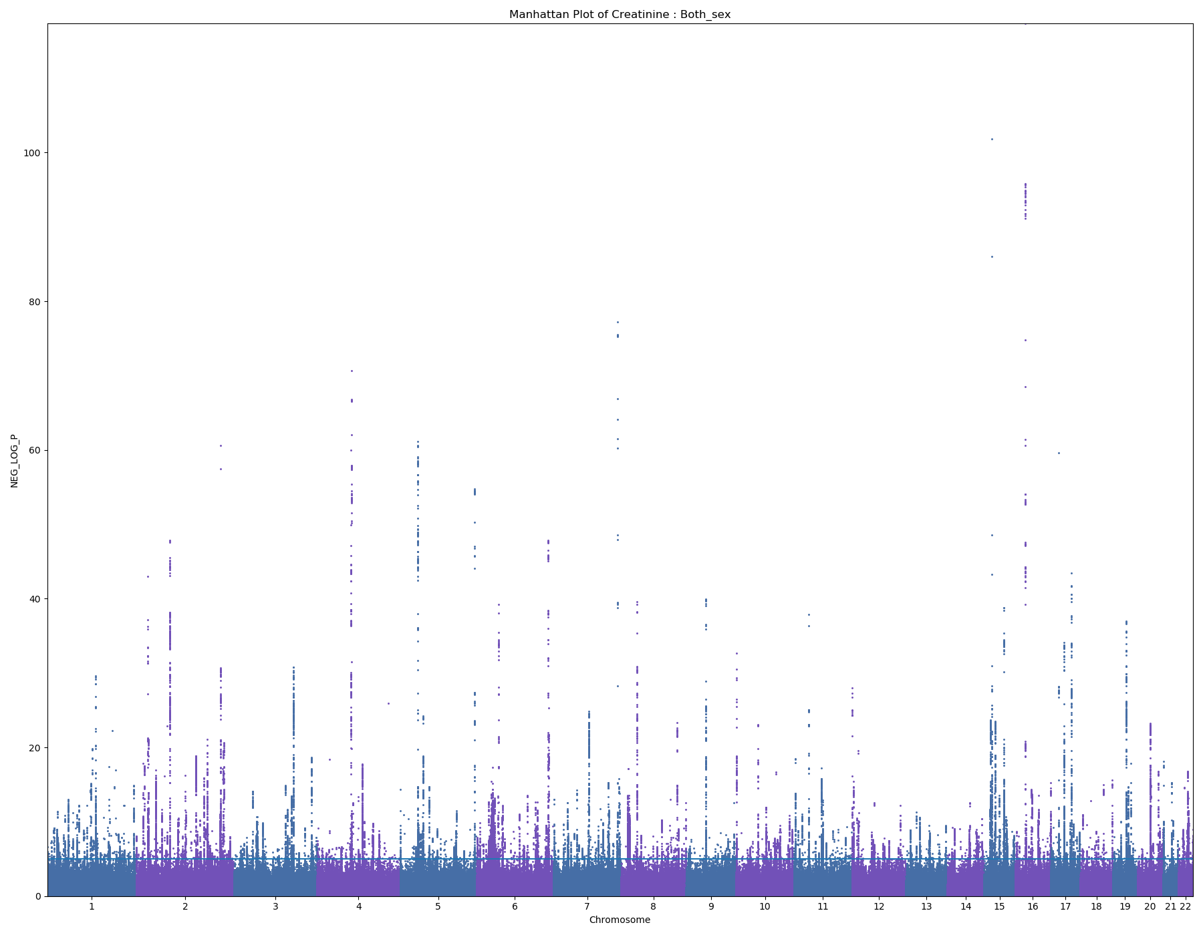
Creatinine
409989 samples

Slide 11

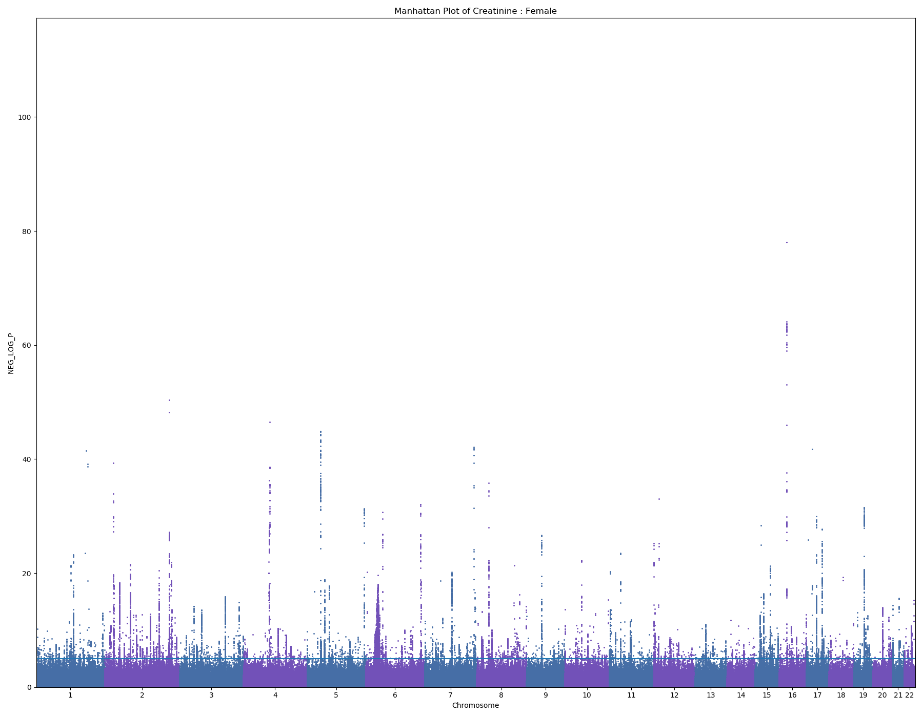
Creatinine
Male – 188187 samples
Female – 221802 samples

Slide 12
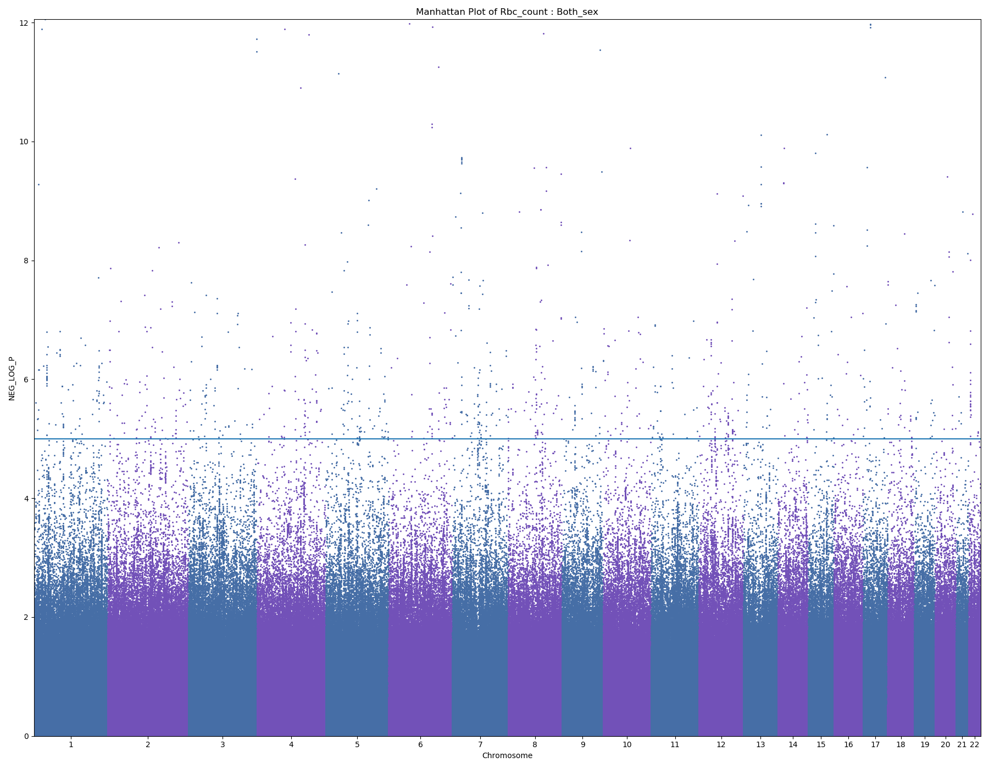
RBC Count
2385 samples

Slide 13
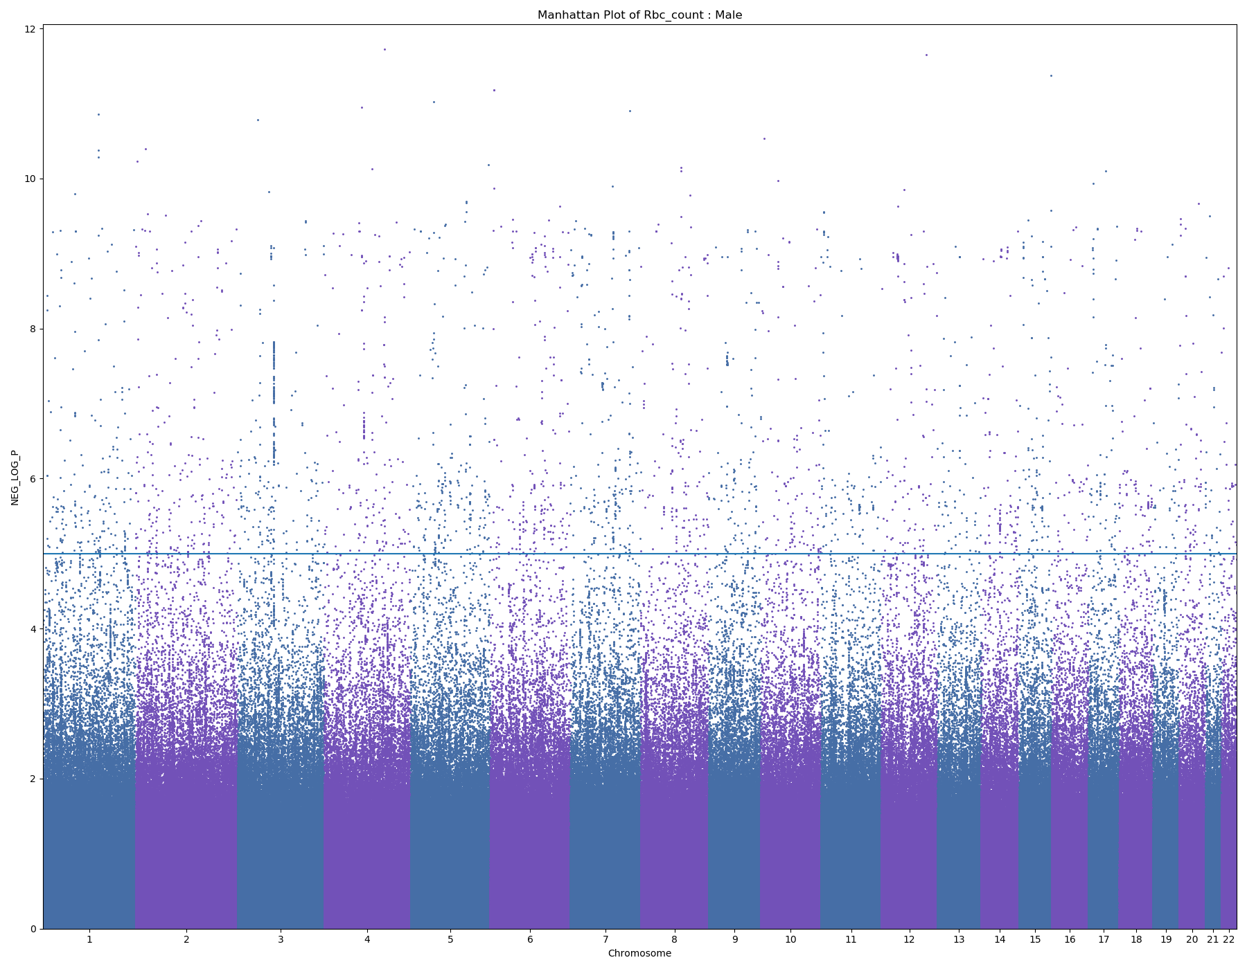
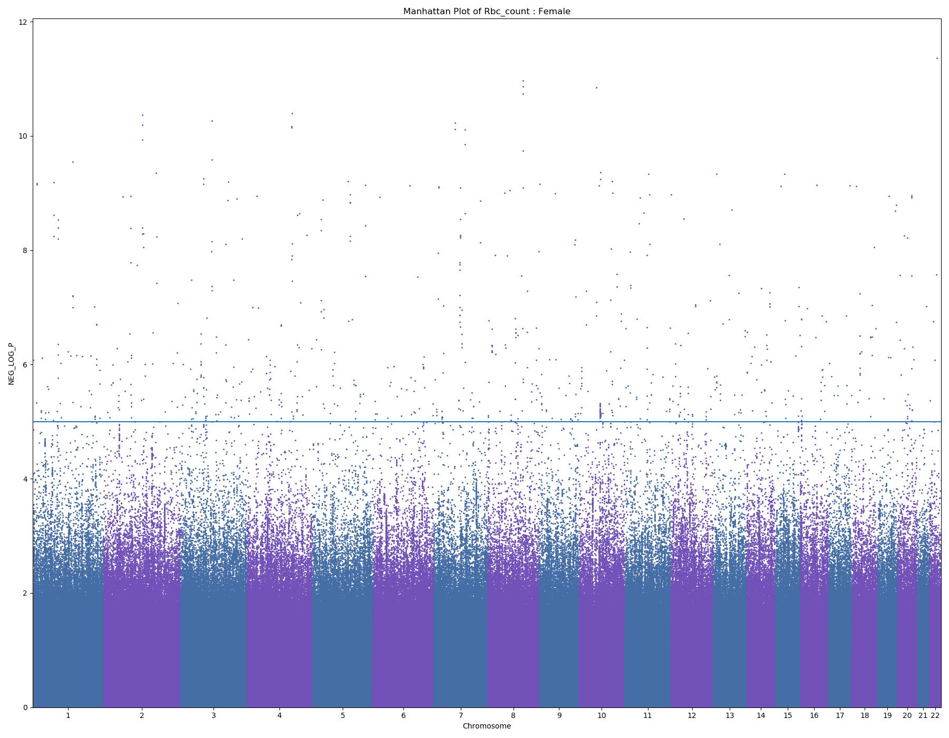
RBC Count
Male – 1052 samples
Female – 1333 samples

Slide 14
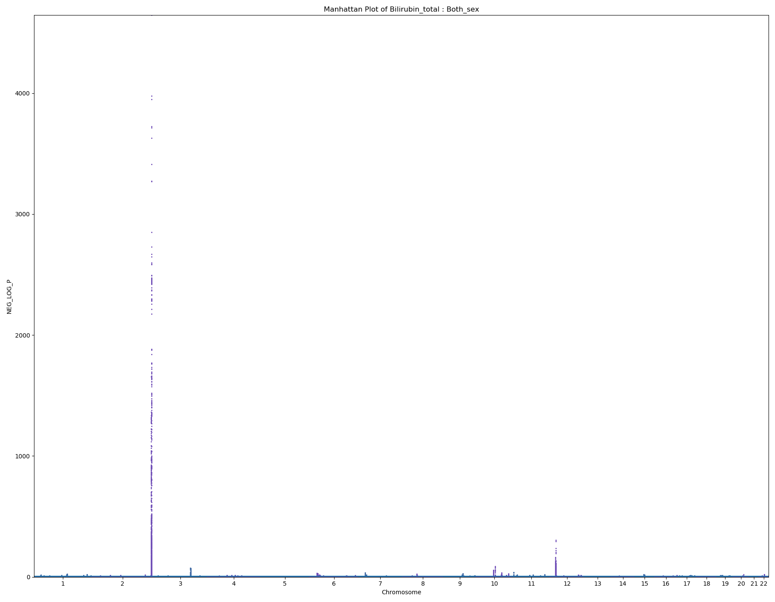
Total Bilirubin
408496 samples

Slide 15
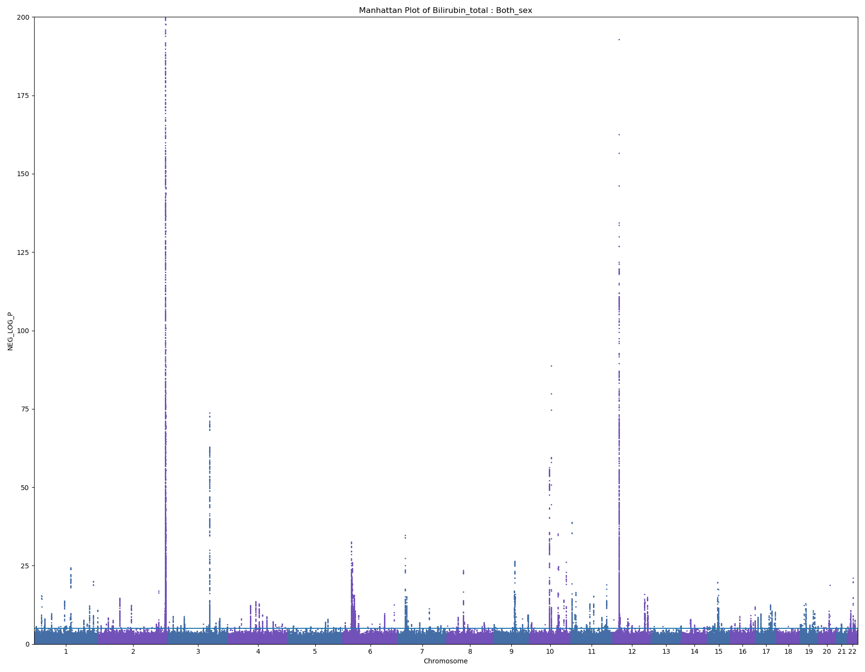
Total Bilirubin Zoomed in

Slide 16
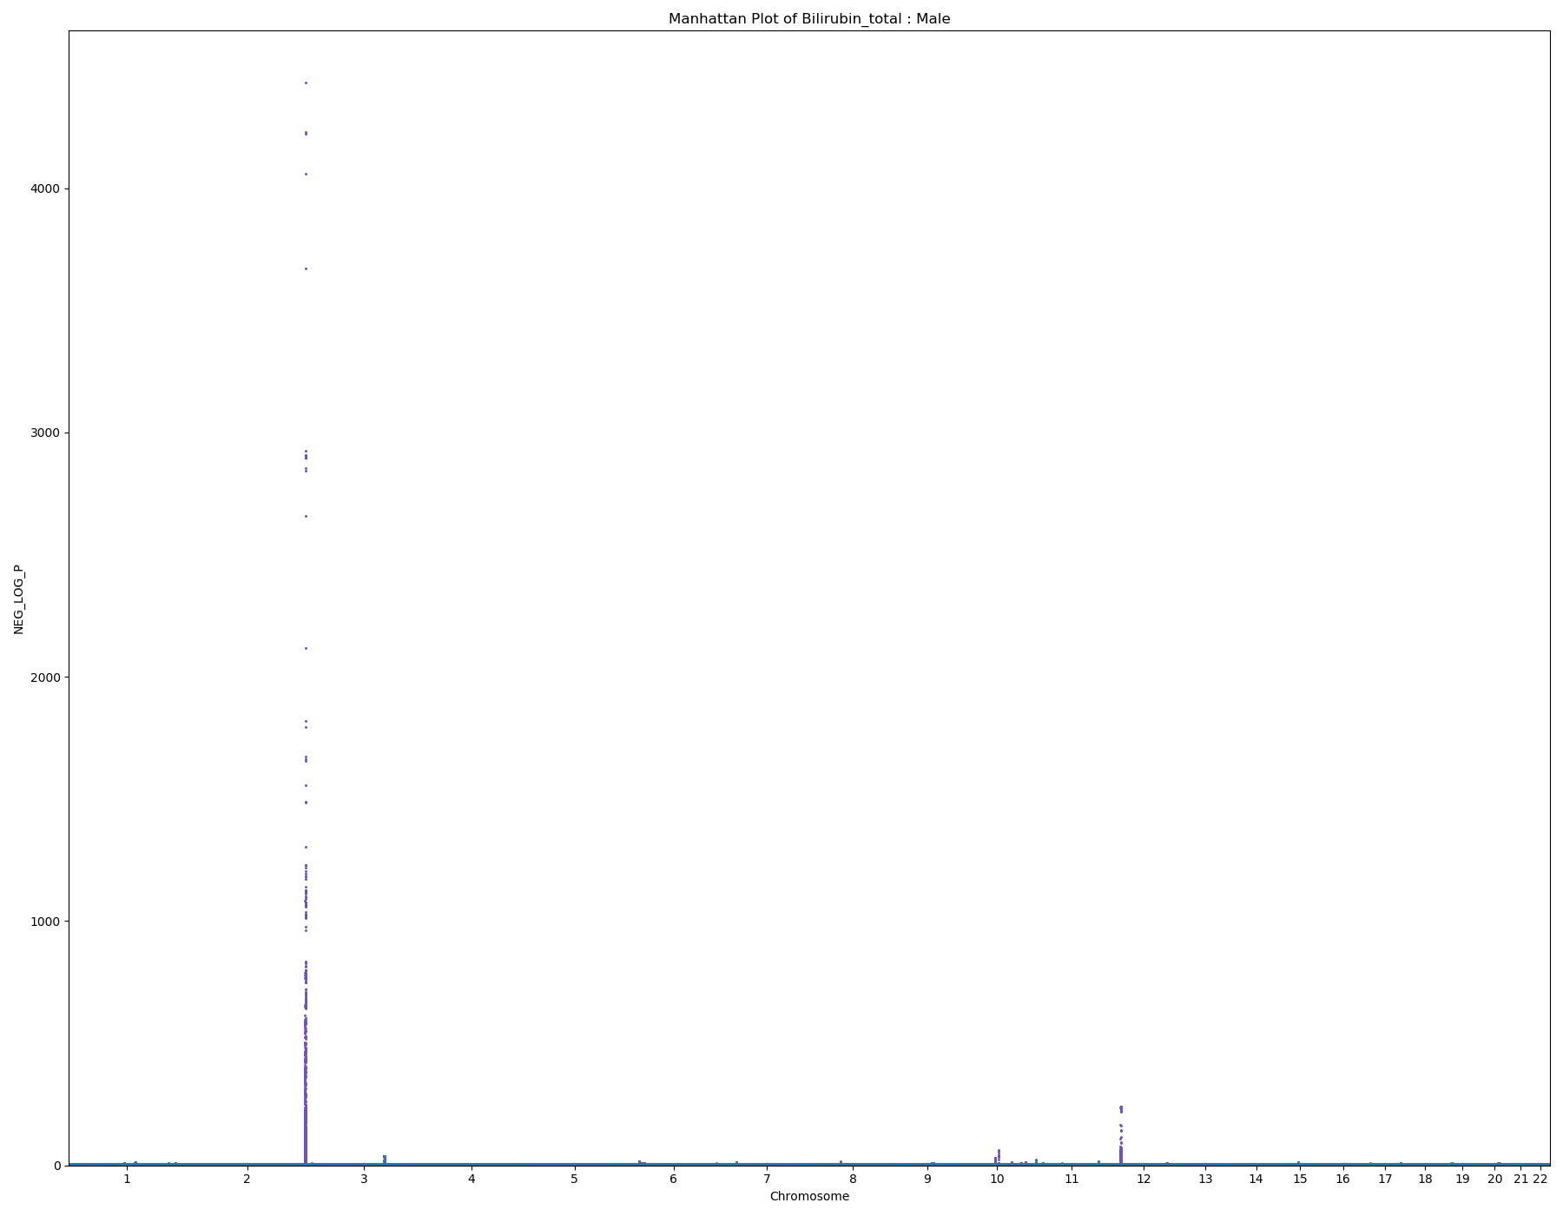
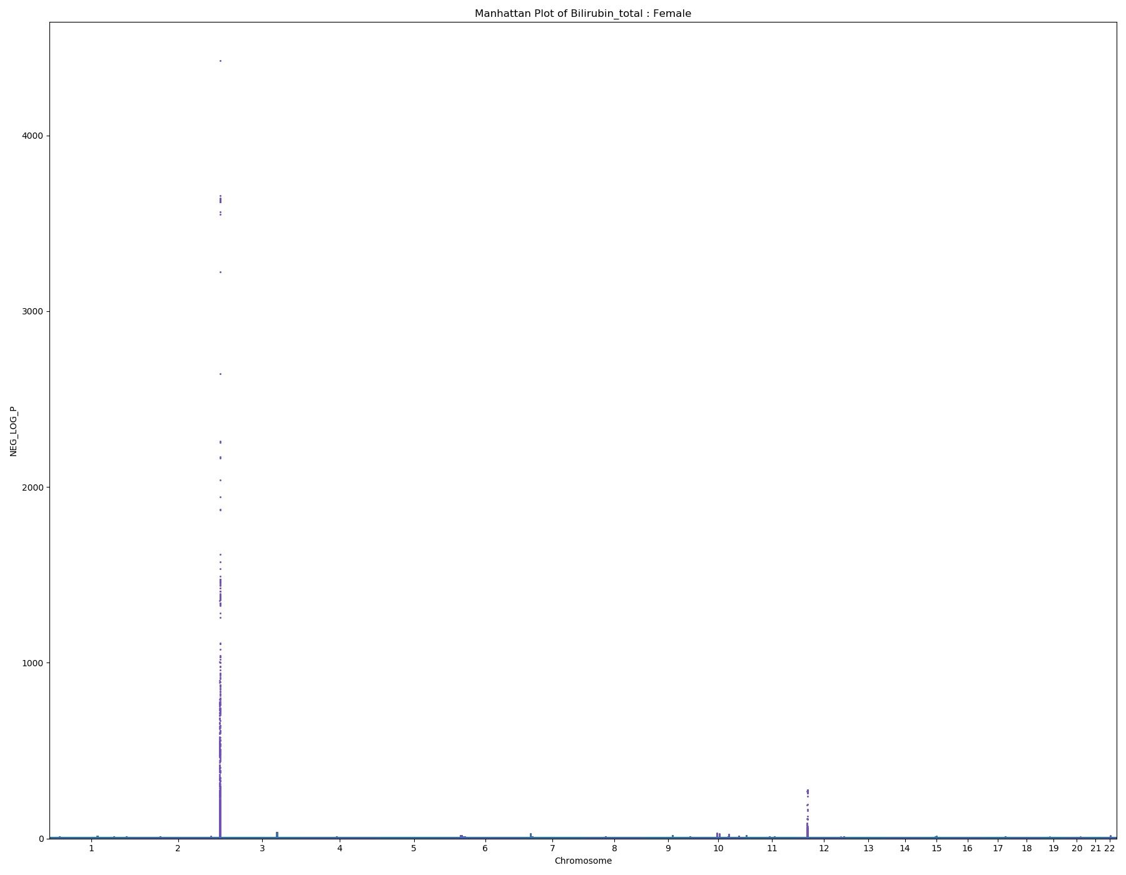
Total Bilirubin
Male – 187497 samples
Female – 220999 samples

Slide 17
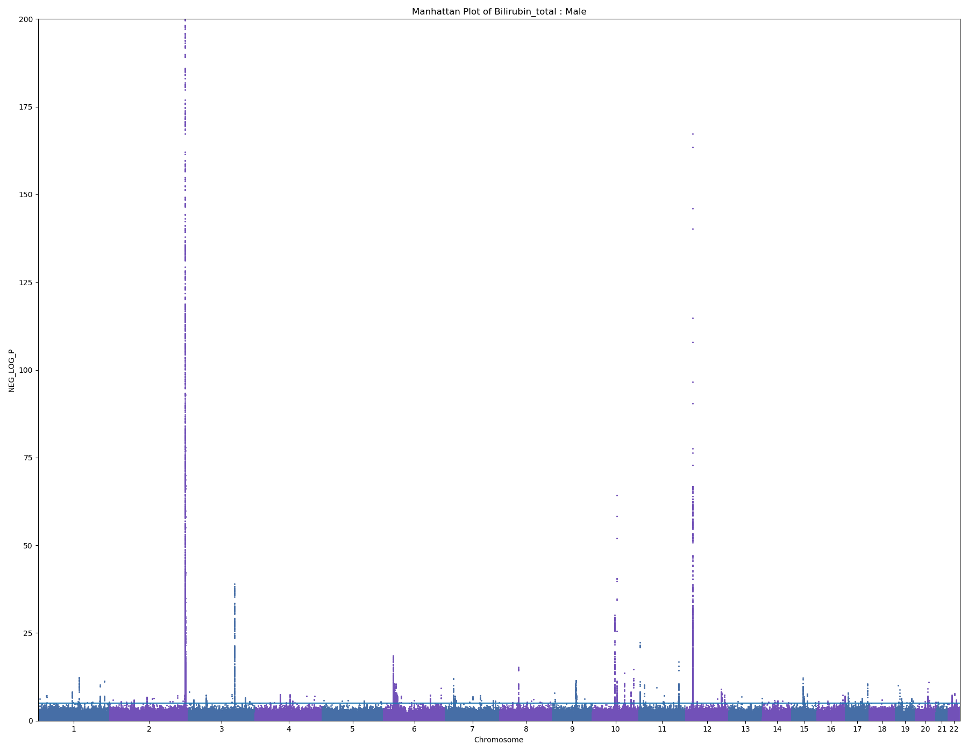
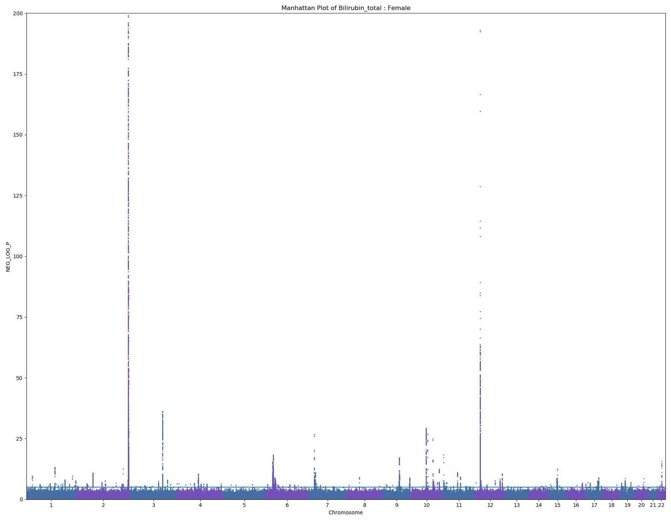
Total Bilirubin - Zoomed in
Male
Female

Slide 18
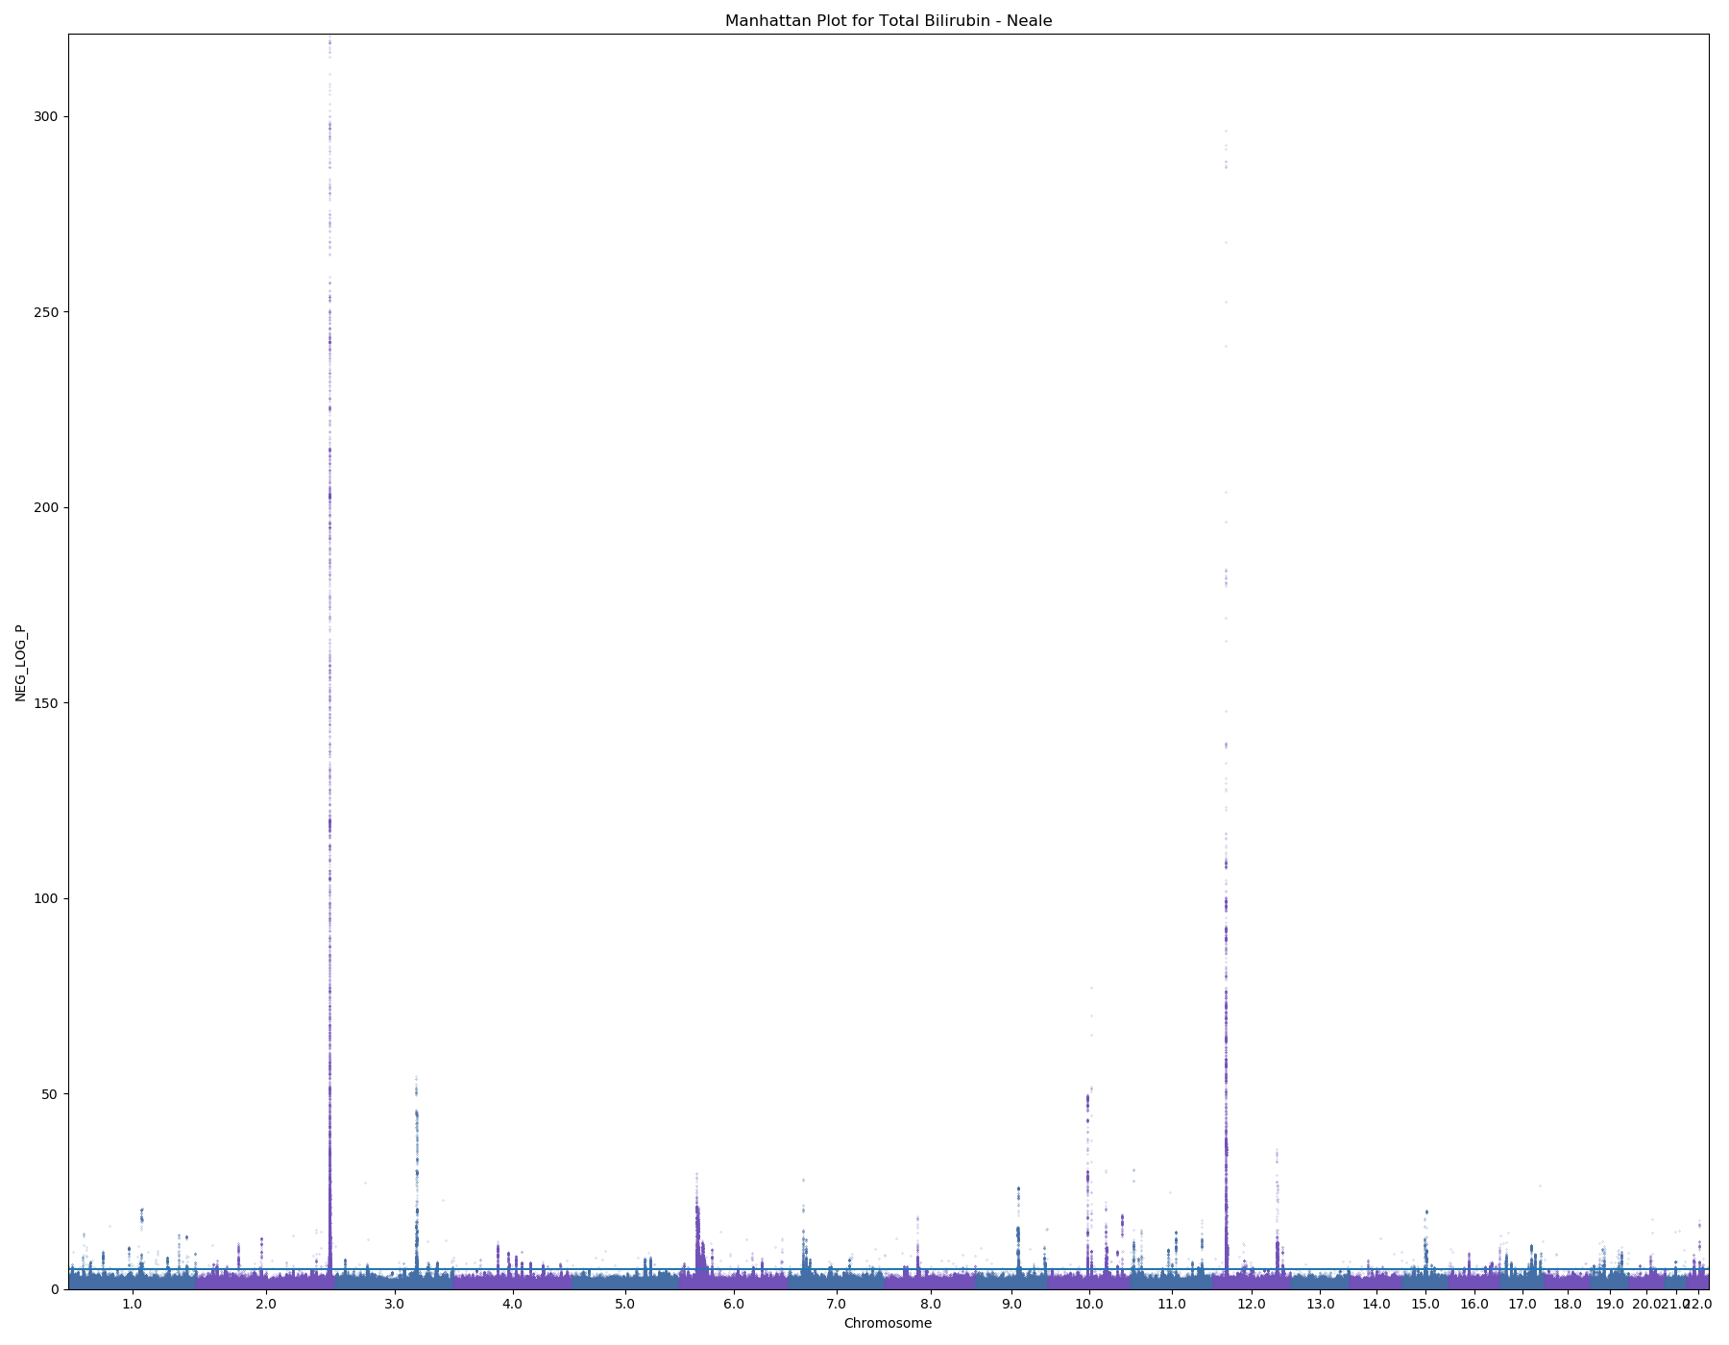
Total Bilirubin – Neale Lab
349839 samples

Slide 19
LDSC
GWAS |  | My LDSC |  | Actual Neale
Phenotype | Sex | Heritability | Intercept | Heritability | Intercept
Height | Both | 0.419 | 1.6768 | 0.485 | 1.313
 | Female | 0.4298 | 1.3777
 | Male | 0.434 | 1.309
Testosterone | Both | 0.0815 | 1.0731 | 0.0771 | 1.062
 | Female | 0.0506 | 1.0385
 | Male | 0.166 | 1.0725
BMI | Both | 0.2275 | 1.2145 | 0.248 | 1.105
 | Female | 0.2422 | 1.0961
 | Male | 0.2563 | 1.0774
IGF-1 | Both | 0.1987 | 1.2771 | 0.253 | 1.125
 | Female | 0.2032 | 1.1672
 | Male | 0.2382 | 1.1193
Total Bilirubin | Both |  |  | 0.543 | 0.7779
 | Female
 | Male
Creatinine | Both | 0.0954 | 1.1313 | 0.211 | 1.093
 | Female | 0.1264 | 1.0819
 | Male | 0.0909 | 1.0629
RBC Count** | Both | 0.1499 | 0.9977 | 0.234 | 1.156
 | Female | 0.7225 | 0.9955
 | Male | 0.0145 | 0.9947

